Slide 1

Real Estate Analysis

Slide 2
Team Members
Harshali Chaudhari.
Neha Jhade.
B. Vignesh.
Riya Patel.
Shapnapriya. K
Vishal Agrawal.
Under The Guidance Of :
Mr. Rahul Kulkarni.

Slide 3
Project Objective
To develop Analysis & Reporting System of Real Estate.
Purchase & Development reports of Property in different cities.

Slide 4
Project Flow
Extract
Homogeneous Sources i.e. Operational Data
(Excel File)
Data Warehouse
(SQL Server)
Transform
Dataset
Reports
(Power BI)
Load
(SSRS)

Slide 5

Source Data
Development_Start_Date
Purchased_Date
City
Locality
Property_Type
Developer_Name
Year_Of_Esablishment
CEO
Number_Of_Employees
Service_Amount
Rating
Investor_Name
City_Investors
sq-ft_cost
Purchase_Amount
Area_Purchased

Slide 6
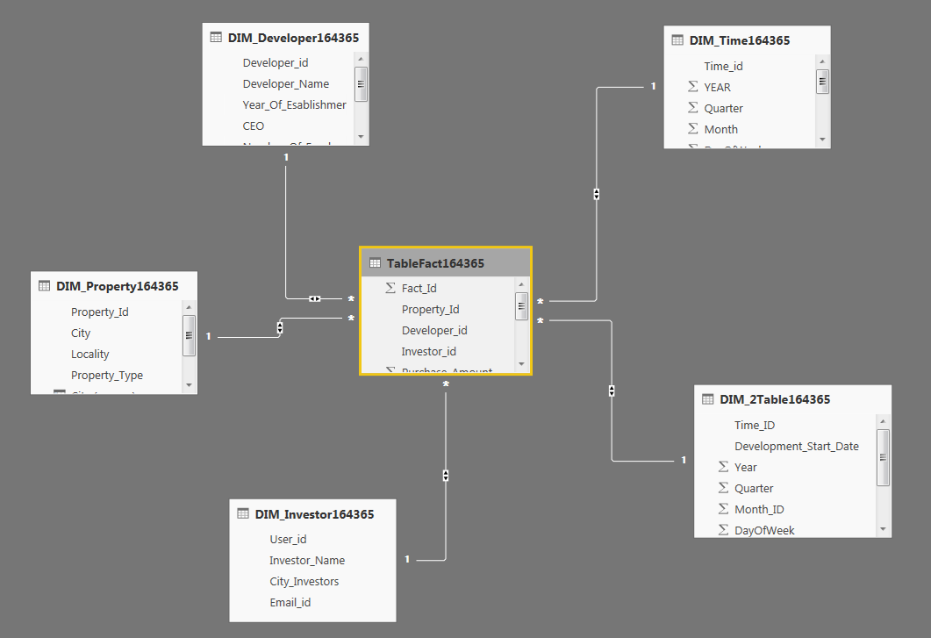
Data Warehouse Star Schema

Slide 7
Staging Table
Sources
Sort & Merge
Data Conversion & New Columns
True
Error
Conditions
False
Union all
Staging Table
Error Table

Slide 8
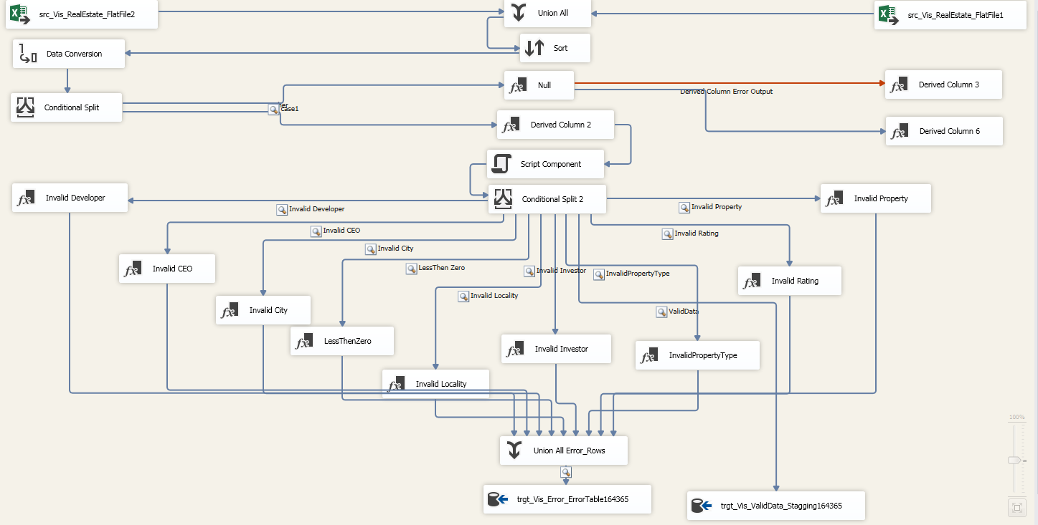

Slide 9
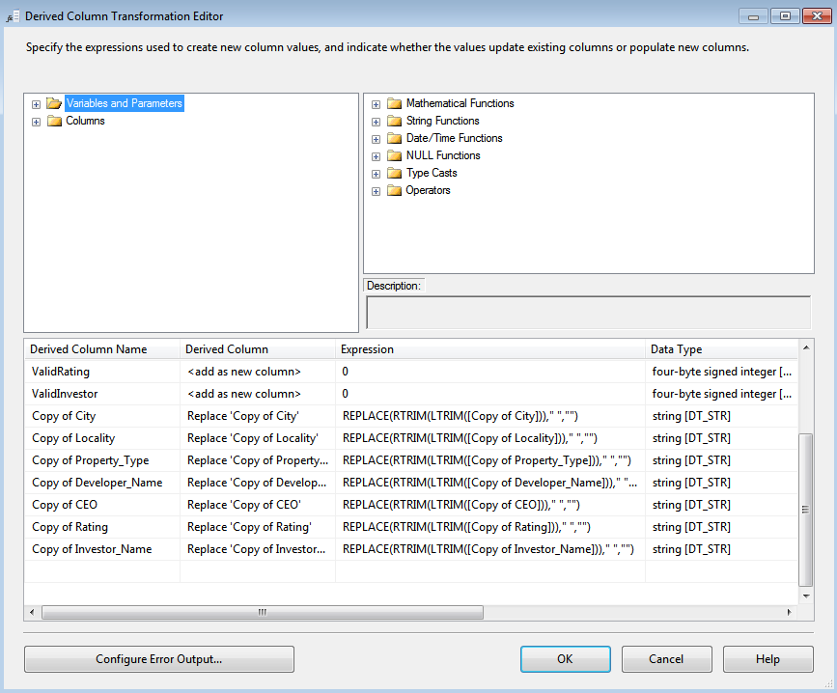
Derived Columns in Data Staging

Slide 10
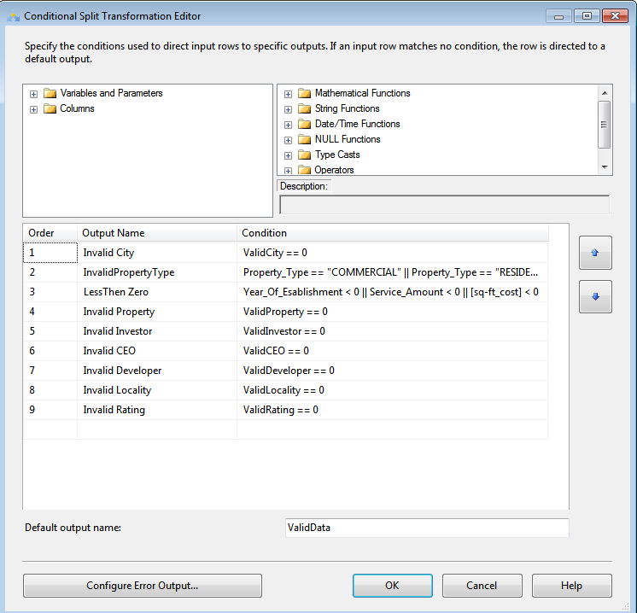
Conditional Split

Slide 11
Populated Tables
Developer Dimensional Table
Property Dimensional Table
Investor Dimensional Table
Developer Time Dimensional Table
Purchase Time Dimensional Table
Fact Table

Slide 12
Development Dimensional Table
OLE DB Cleaned Data Tables
Developer Dimensional Table
Look Up
(Target Table)

Slide 13
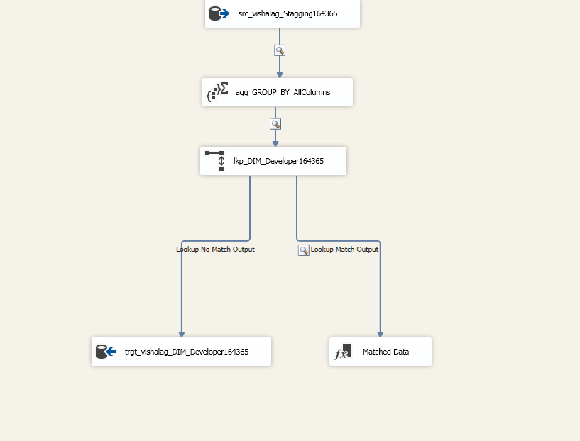

Slide 14
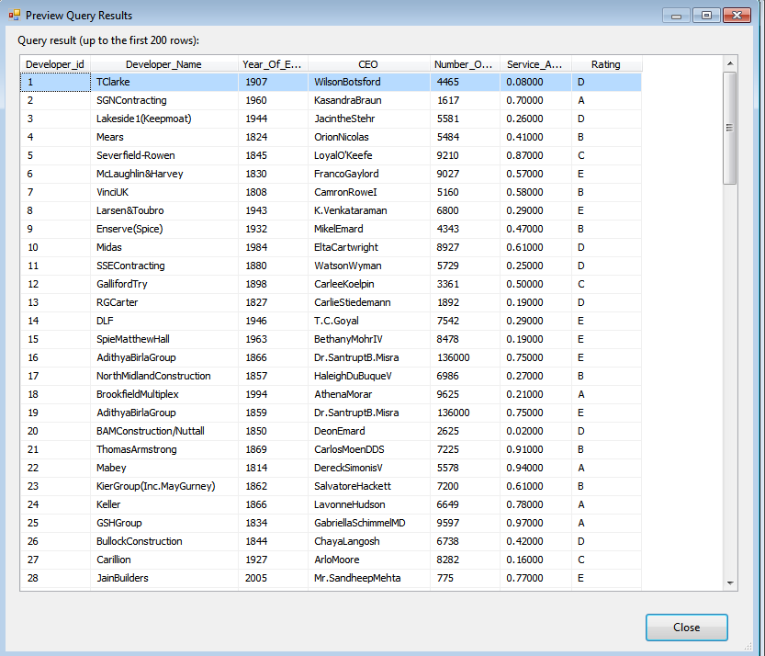
Developer Dimensional Table Data

Slide 15
Property Dimensional Table
OLE DB Cleaned Data Tables
Property Dimensional Table
Look Up
(Target Table)

Slide 16
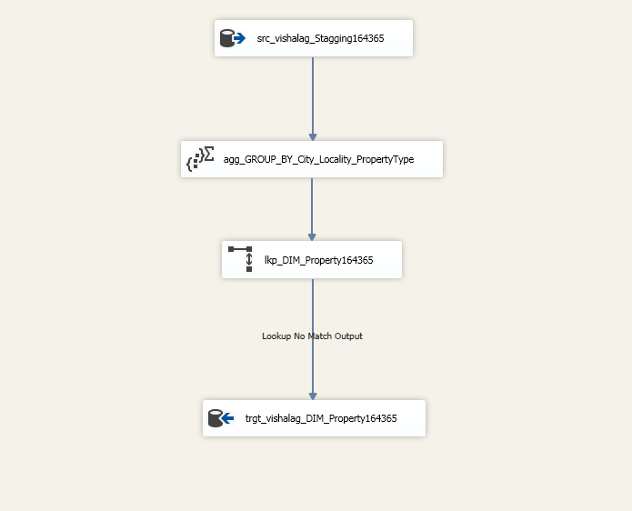

Slide 17
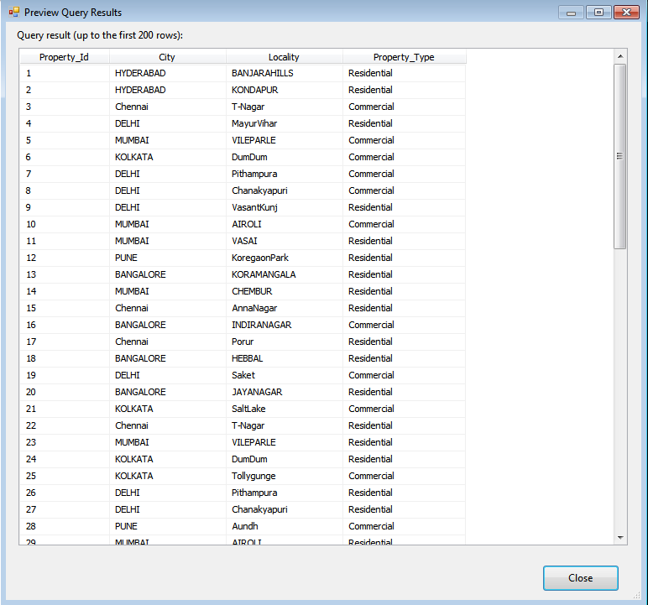
Property Dimensional Table Data

Slide 18
Investor Dimensional Table
OLE DB Cleaned Data Tables
Investor Dimensional Table
Look Up
(Target Table)

Slide 19
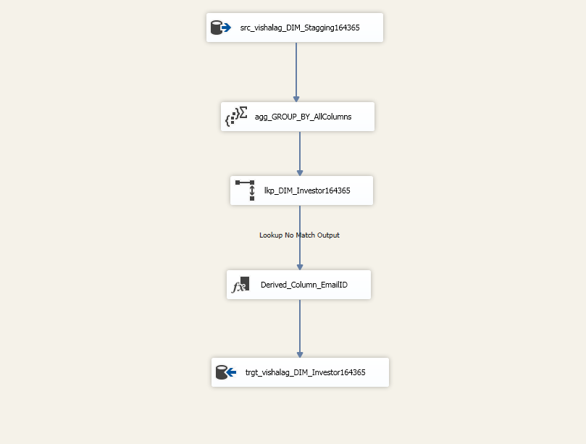

Slide 20
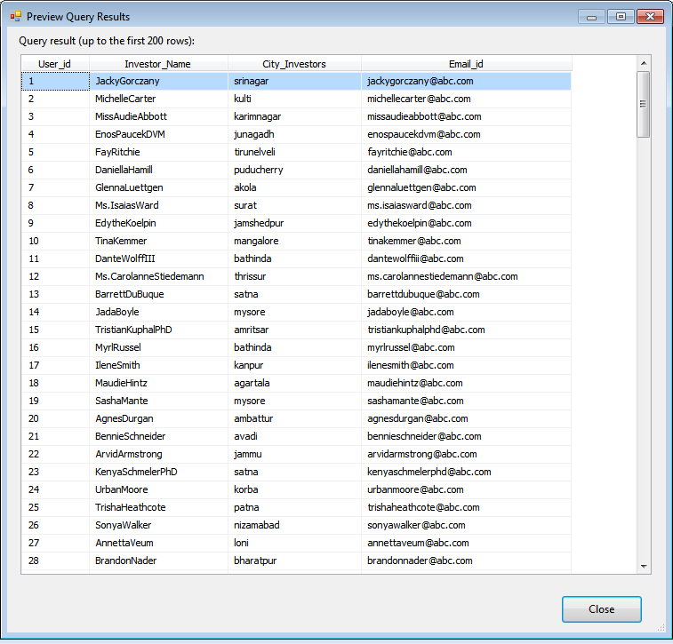
Investor Dimensional Table Data

Slide 21
Developer Time Dimensional Table
OLE DB Cleaned Data Tables
Developer Time Dimensional Table
Look Up
(Target Table)

Slide 22
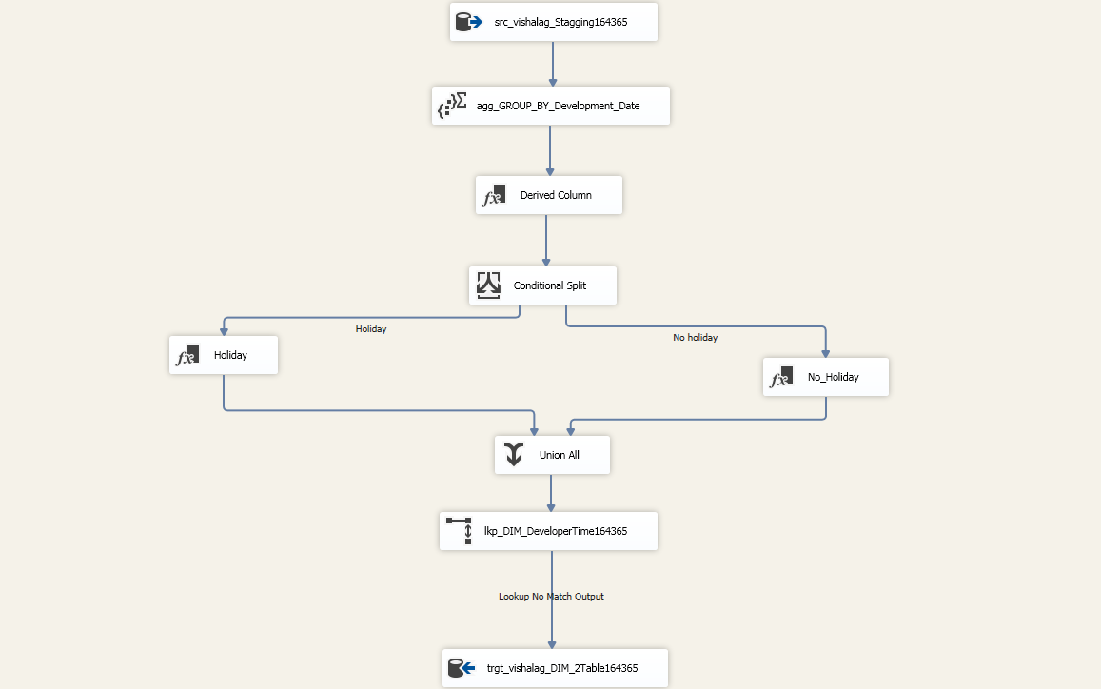

Slide 23
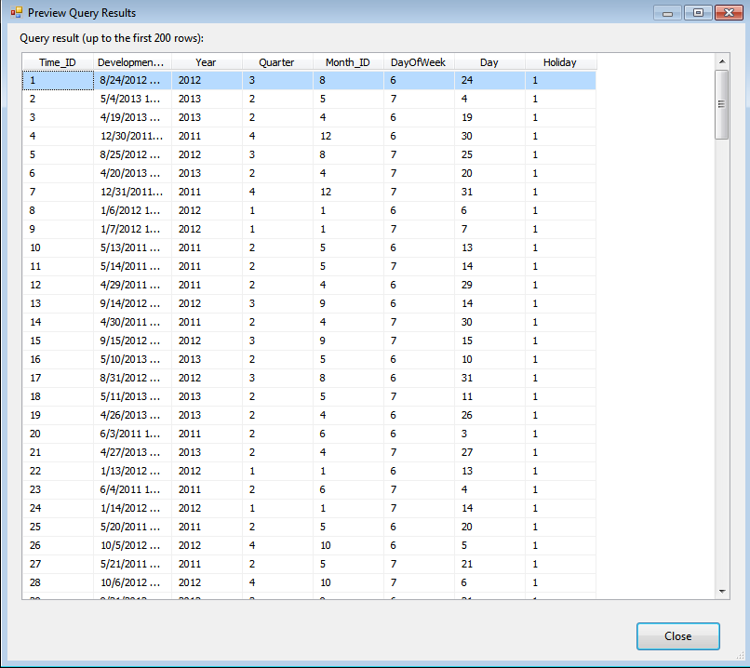
Developer Time Dimensional Table Data

Slide 24
Purchase Time Dimensional Table
Look Up
(Target Table)
Purchase Time Dimensional Table
OLE DB Cleaned Data Tables

Slide 25
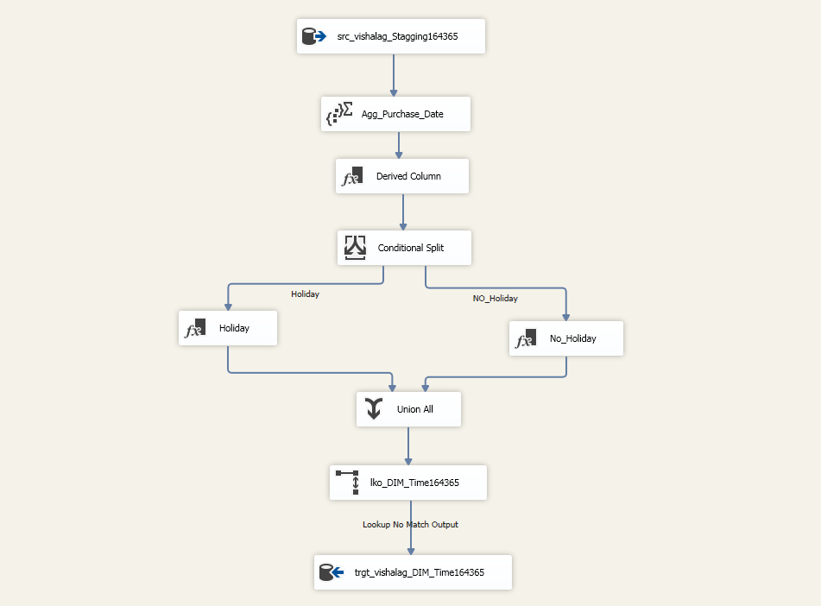

Slide 26
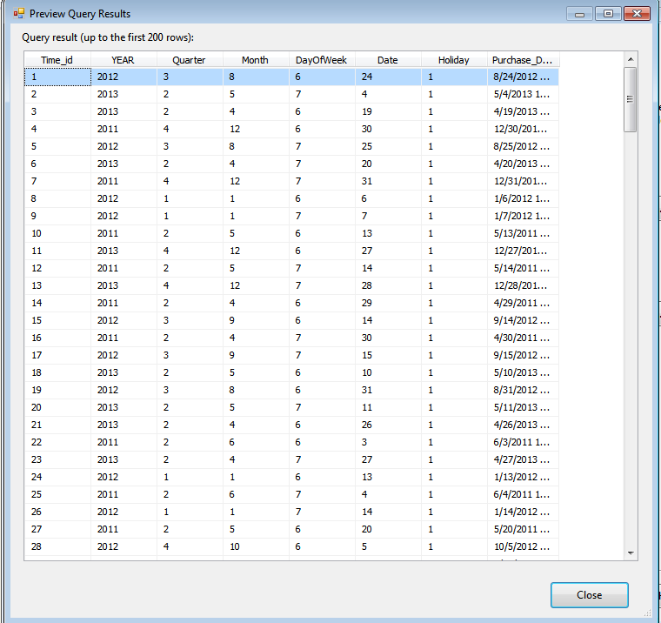
Purchase Time Dimensional Table Data

Slide 27
Populating Fact Table
Developer Dimensional Table
(look up)
Property Dimensional Table
(look up)
Investor Dimensional Table
(look up)
Fact Table
Staging Table
Developer Time Dimensional Table
(look up)
Purchase Time Dimensional Table
(look up)

Slide 28
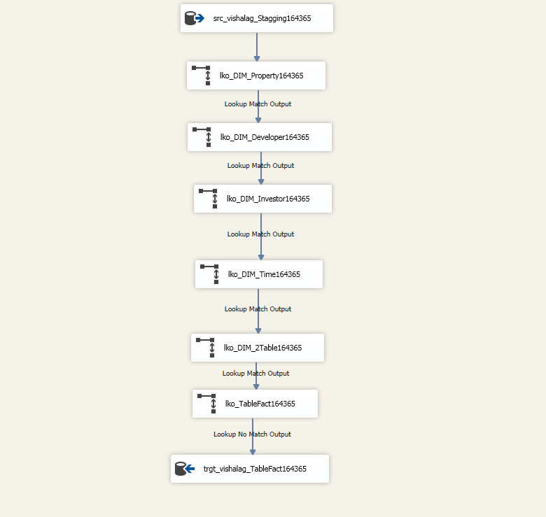

Slide 29
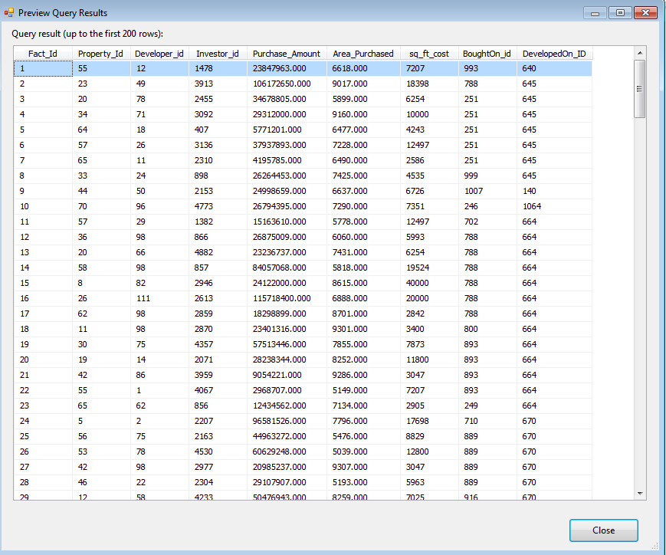
Fact Table Data

Slide 30
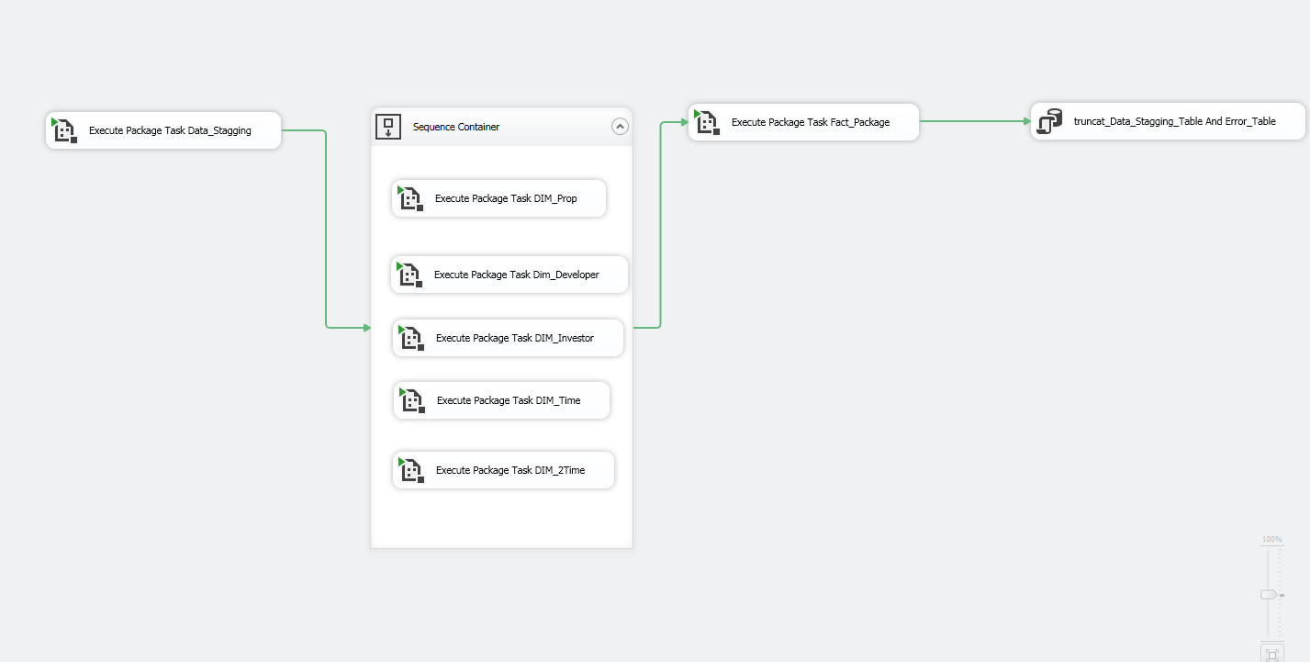
Automation

Slide 31
Reports
Development of cities residentially and commercially
Number of Investors annually for every City
Citi wise ranking of developers
Total Revenue on area purchased
Holiday Purchases
City wise price trends
Profitable Quarters
Comparison of different companies
Purchase Trends
City wise assessment of Investments

Slide 32


PROJECT REPORT
Last data refresh:
1/6/2019 4:24:48 PM India Standard Time
Downloaded at:
1/6/2019 4:26:37 PM India Standard Time

Slide 33
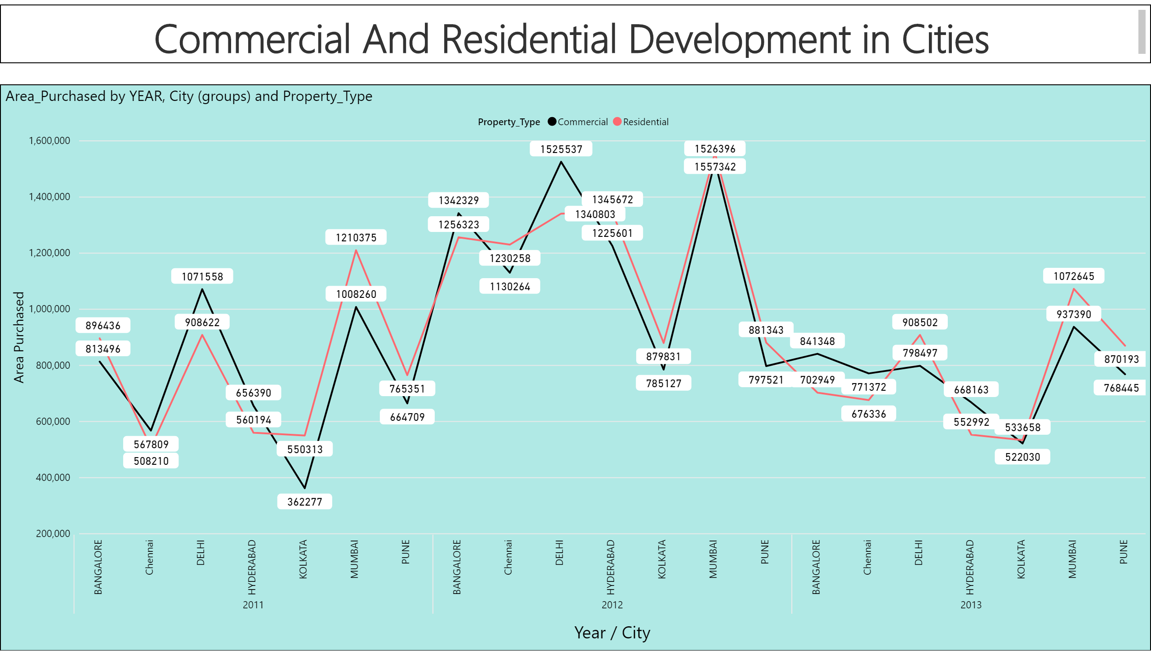

Slide 34
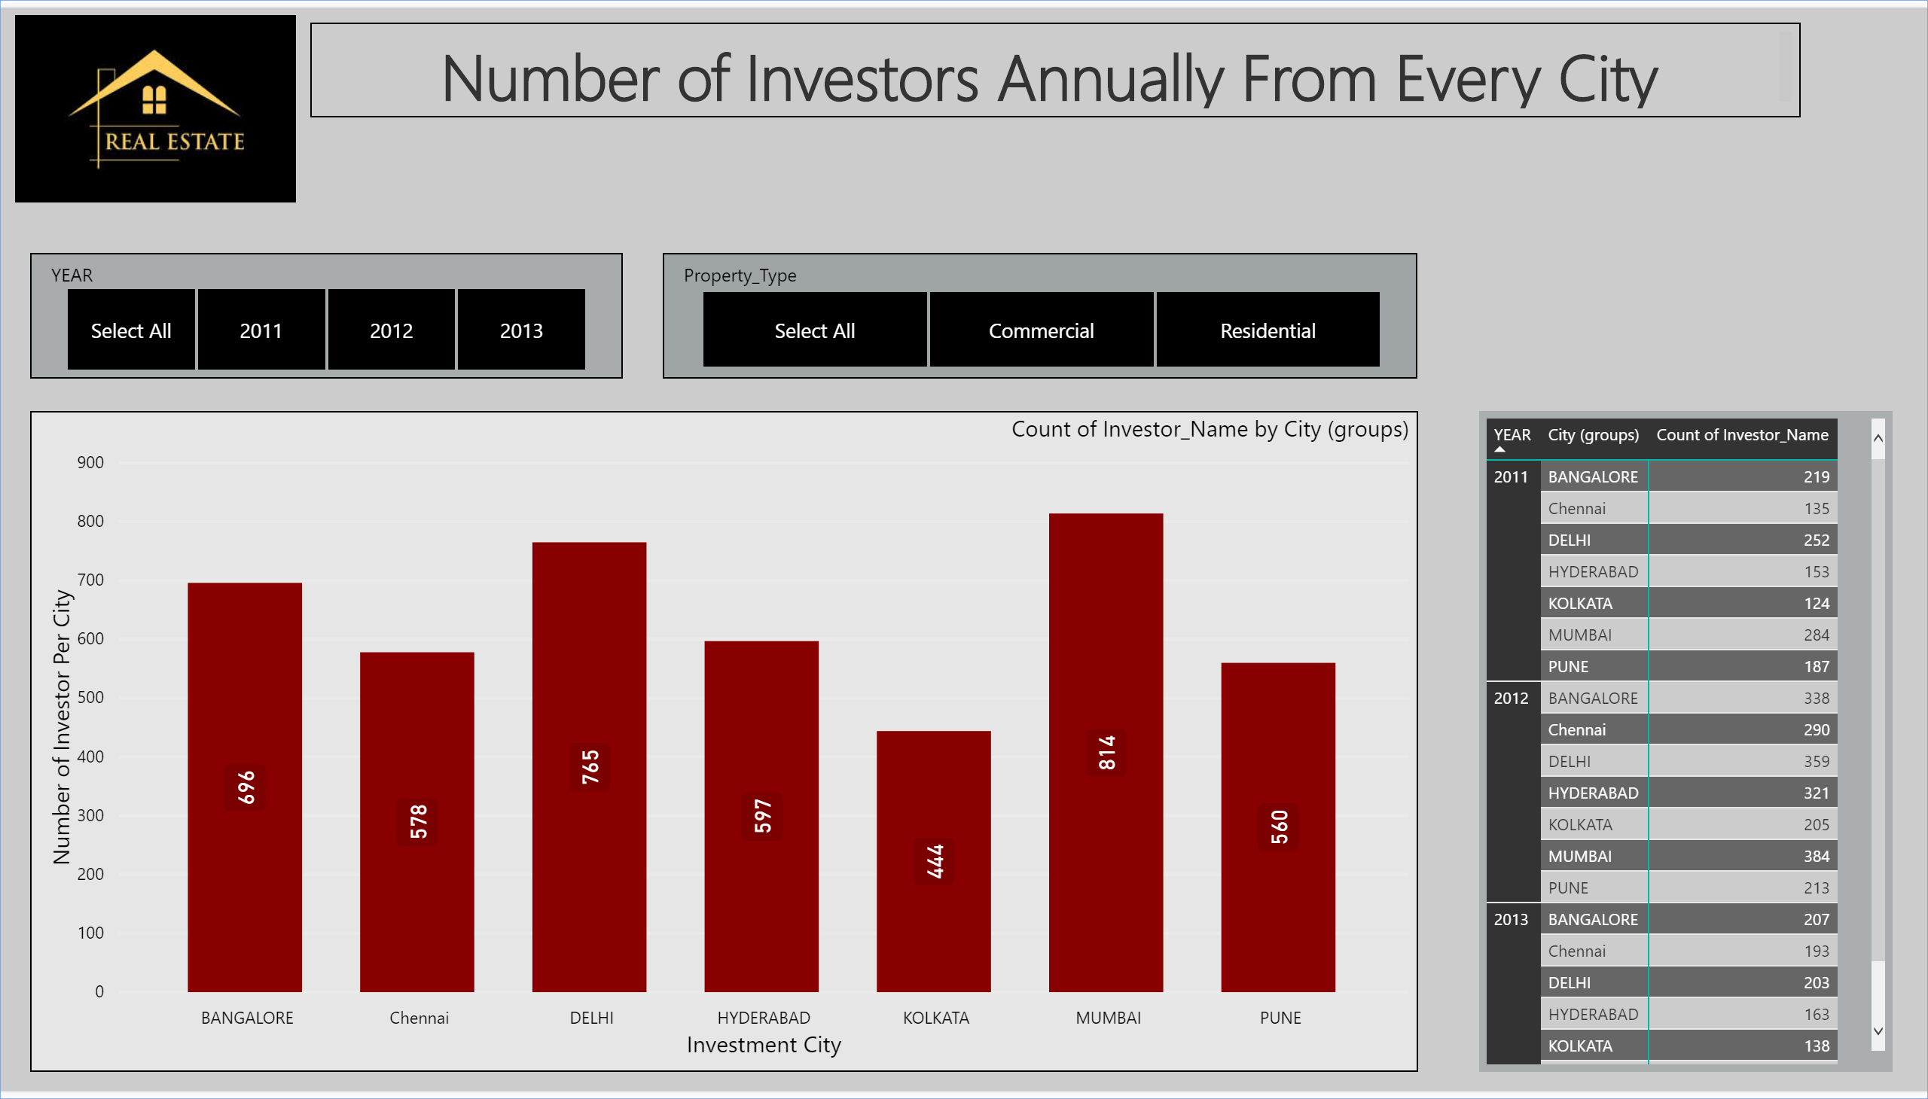

Slide 35
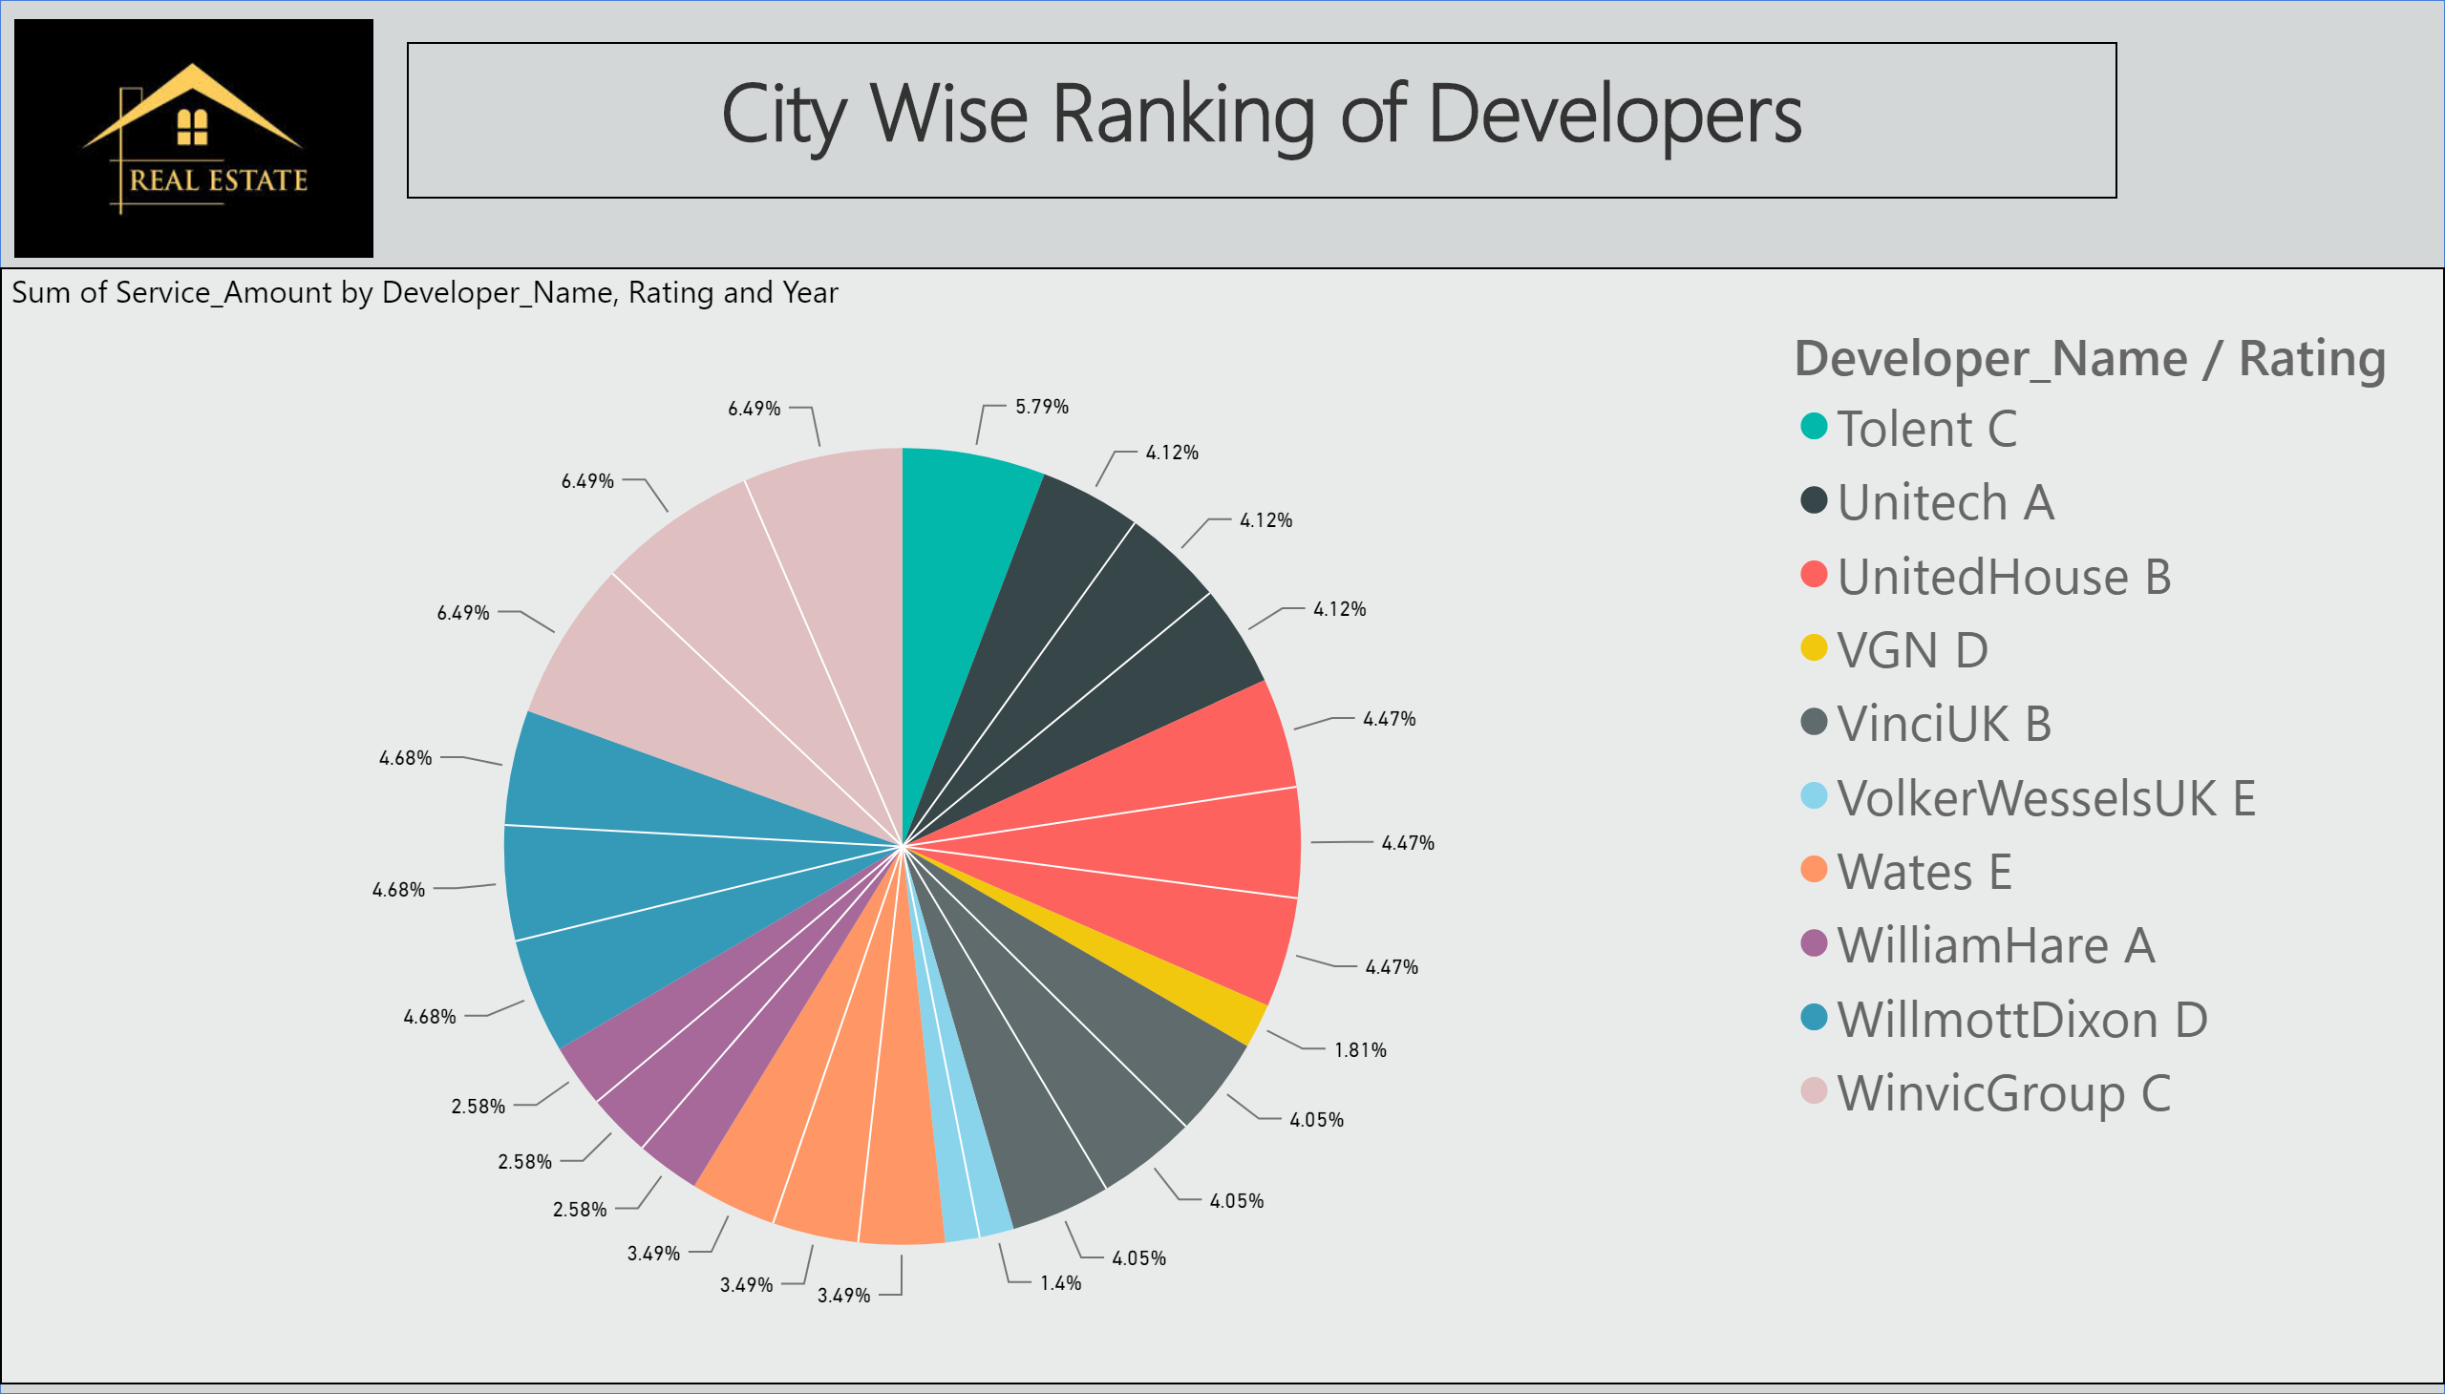

Slide 36
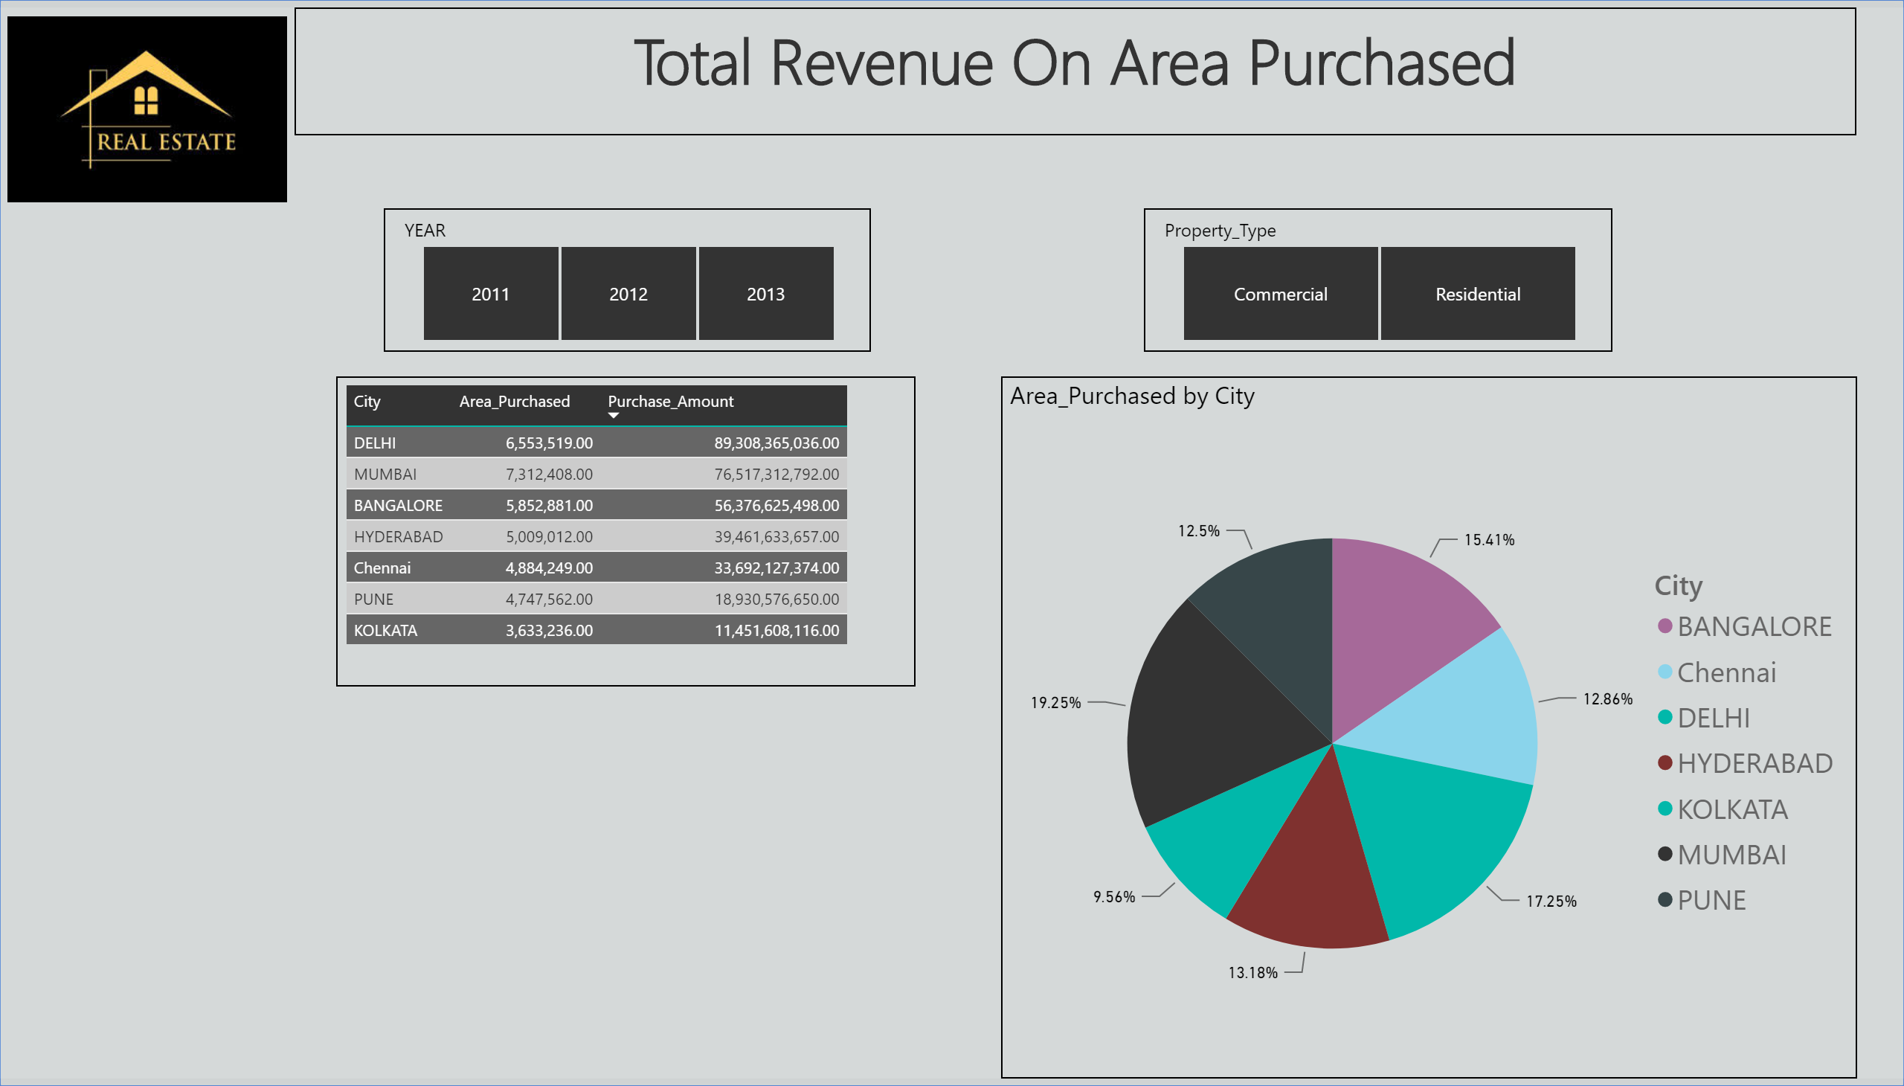

Slide 37
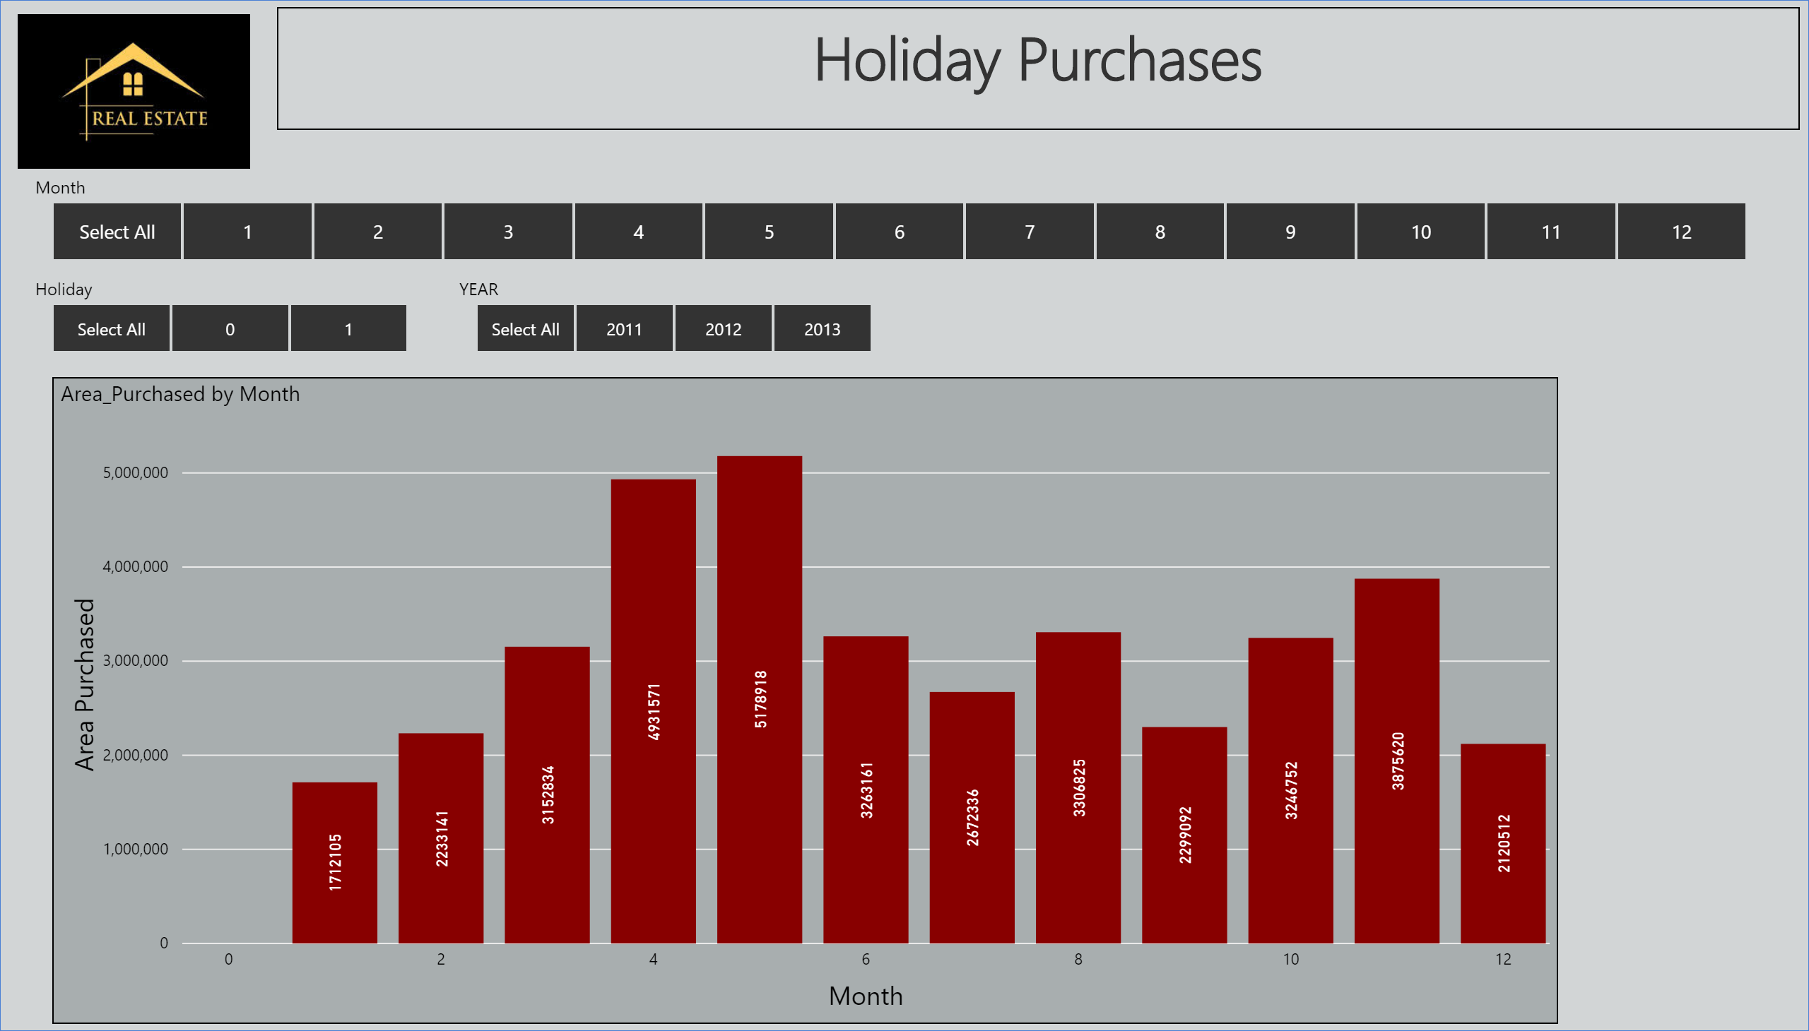

Slide 38
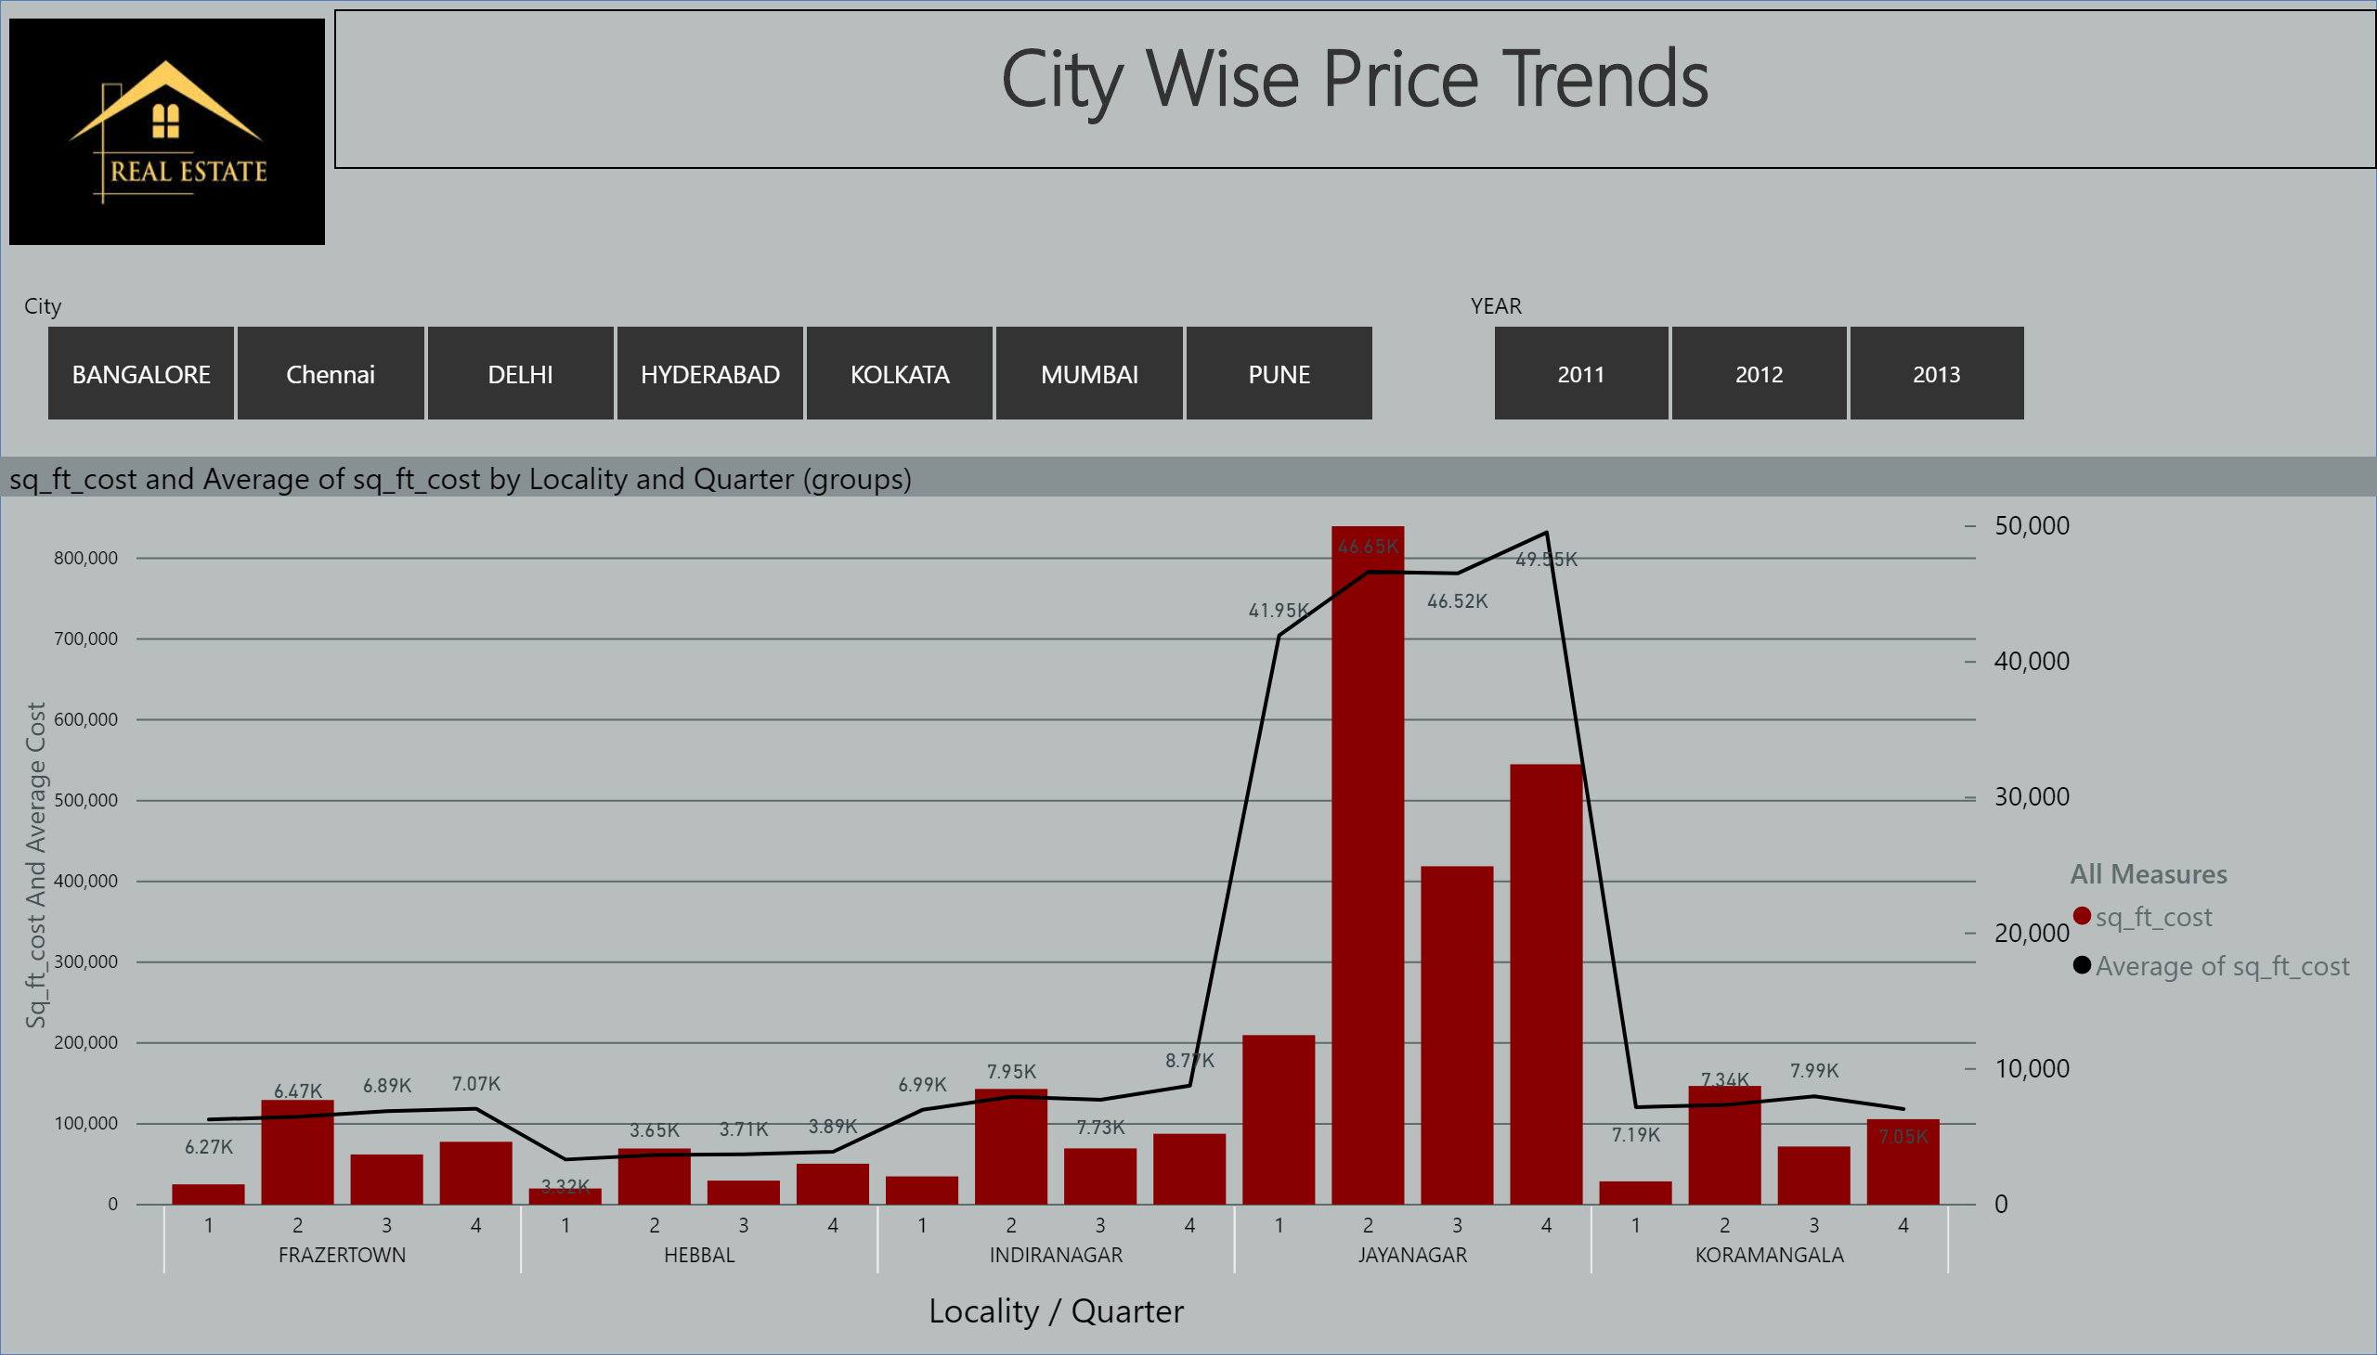

Slide 39
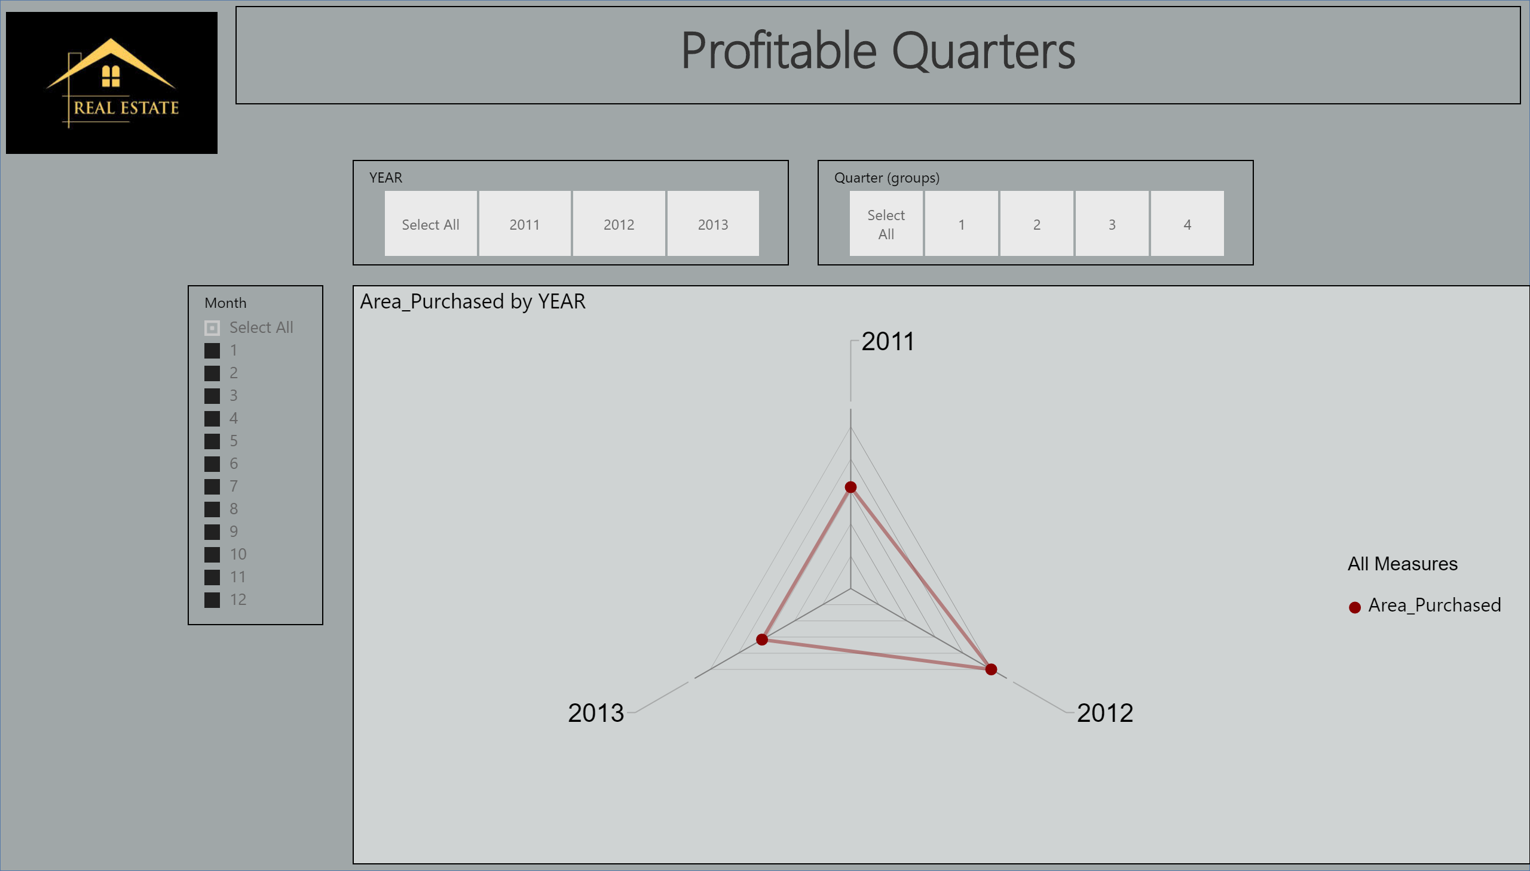

Slide 40
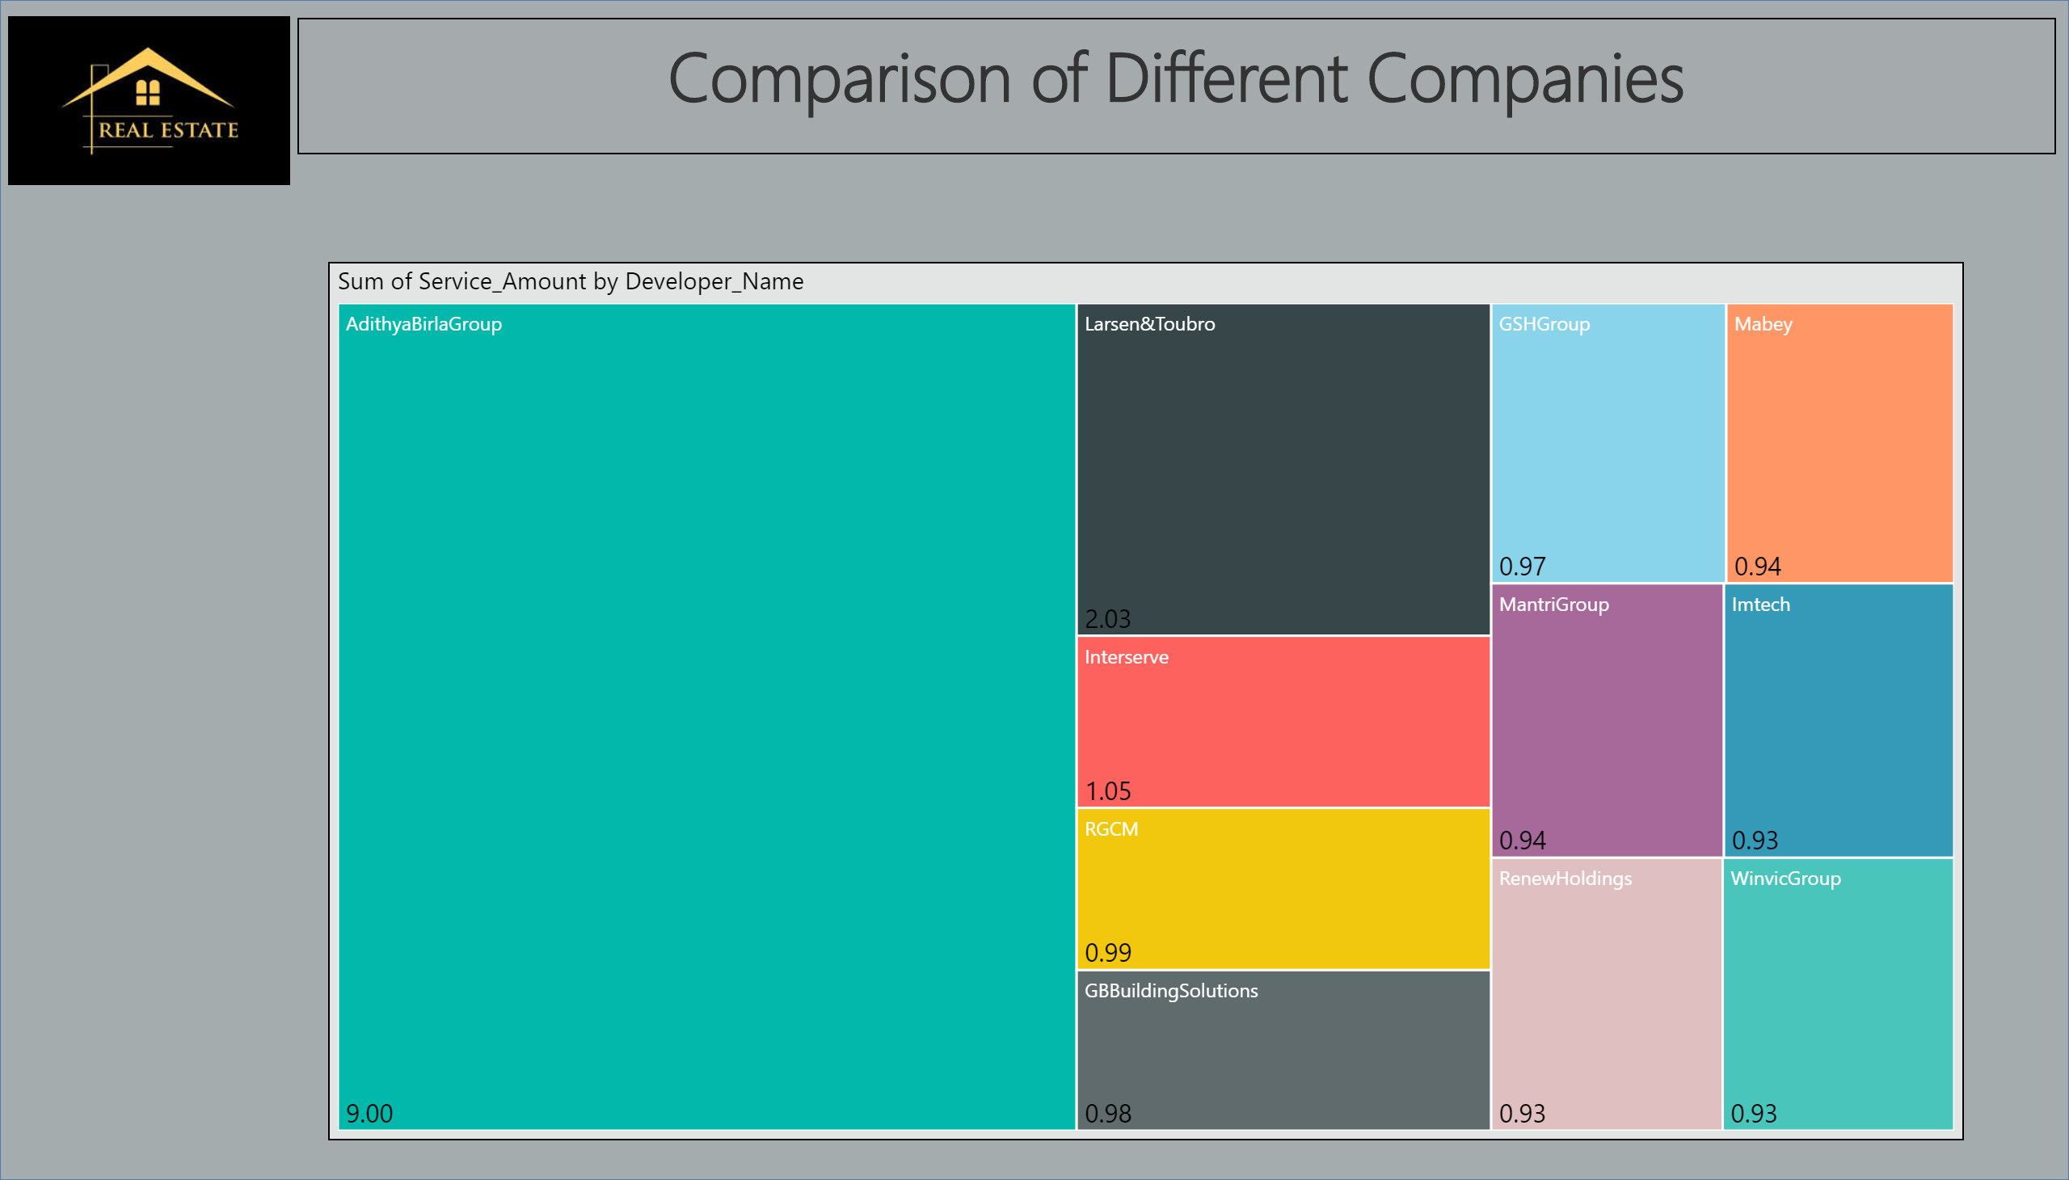

Slide 41
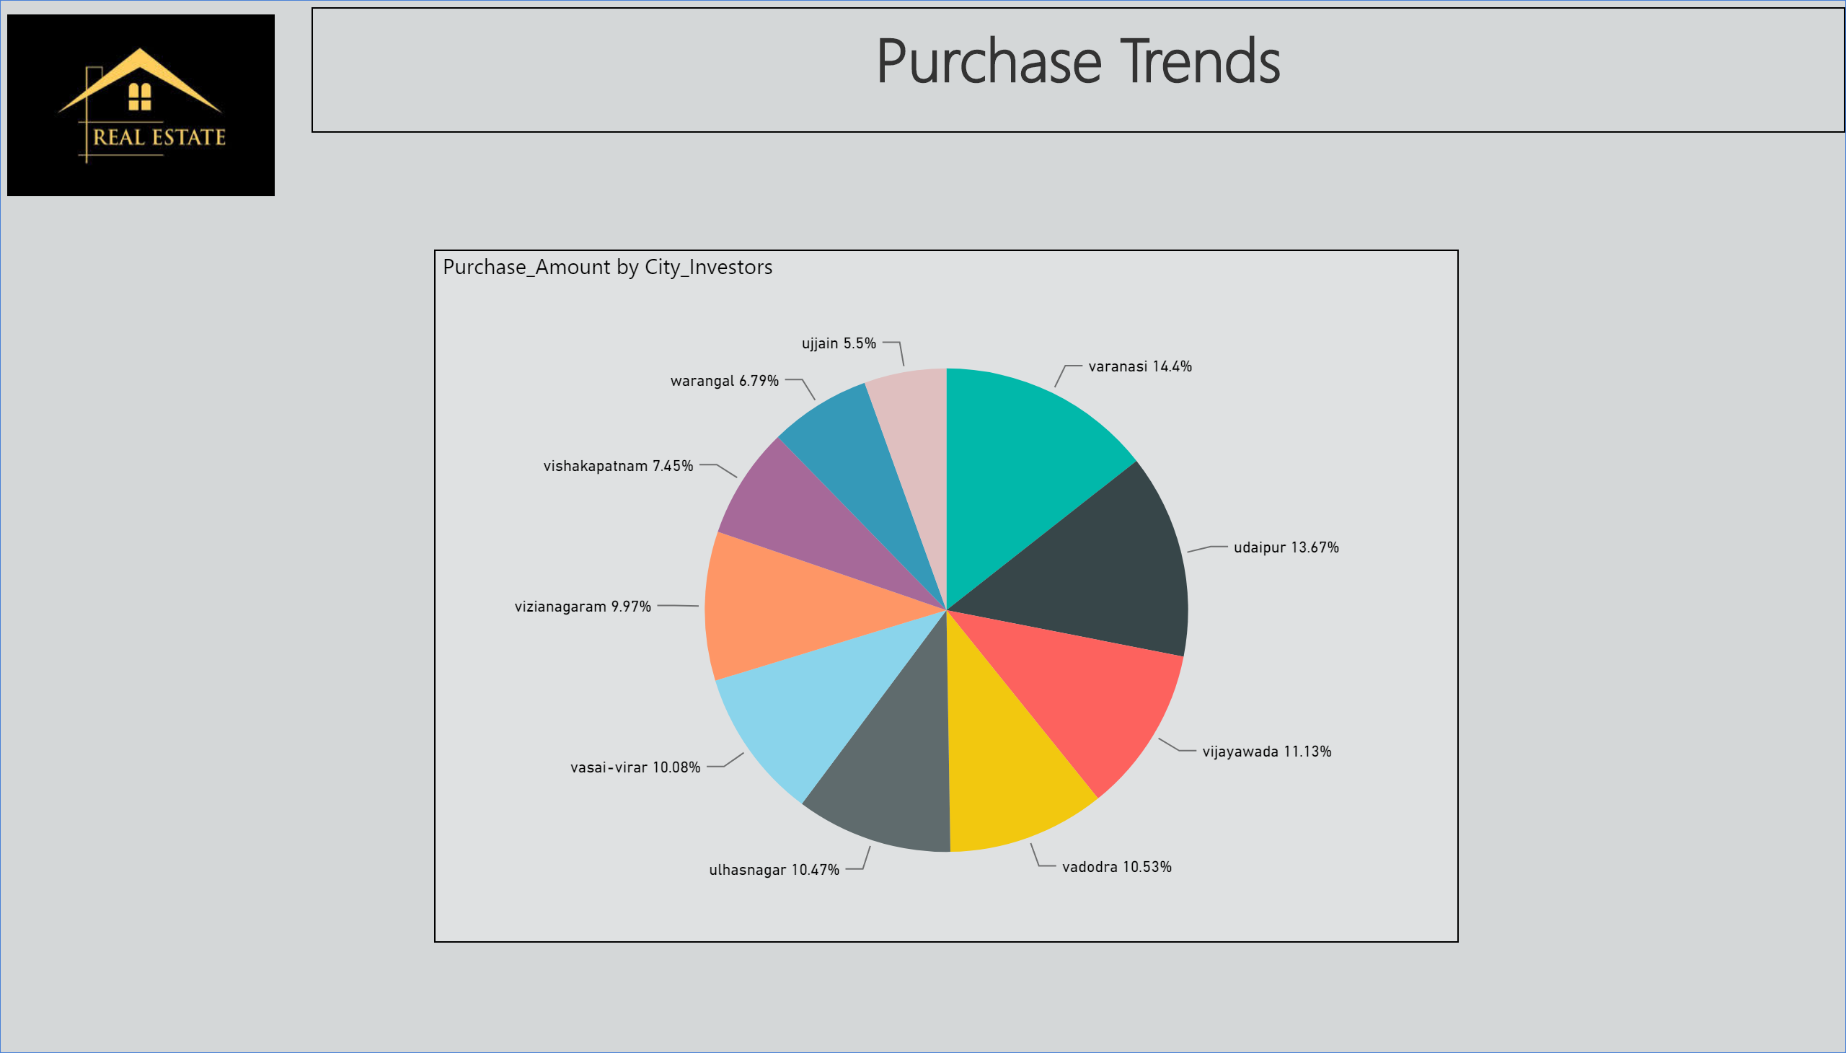

Slide 42
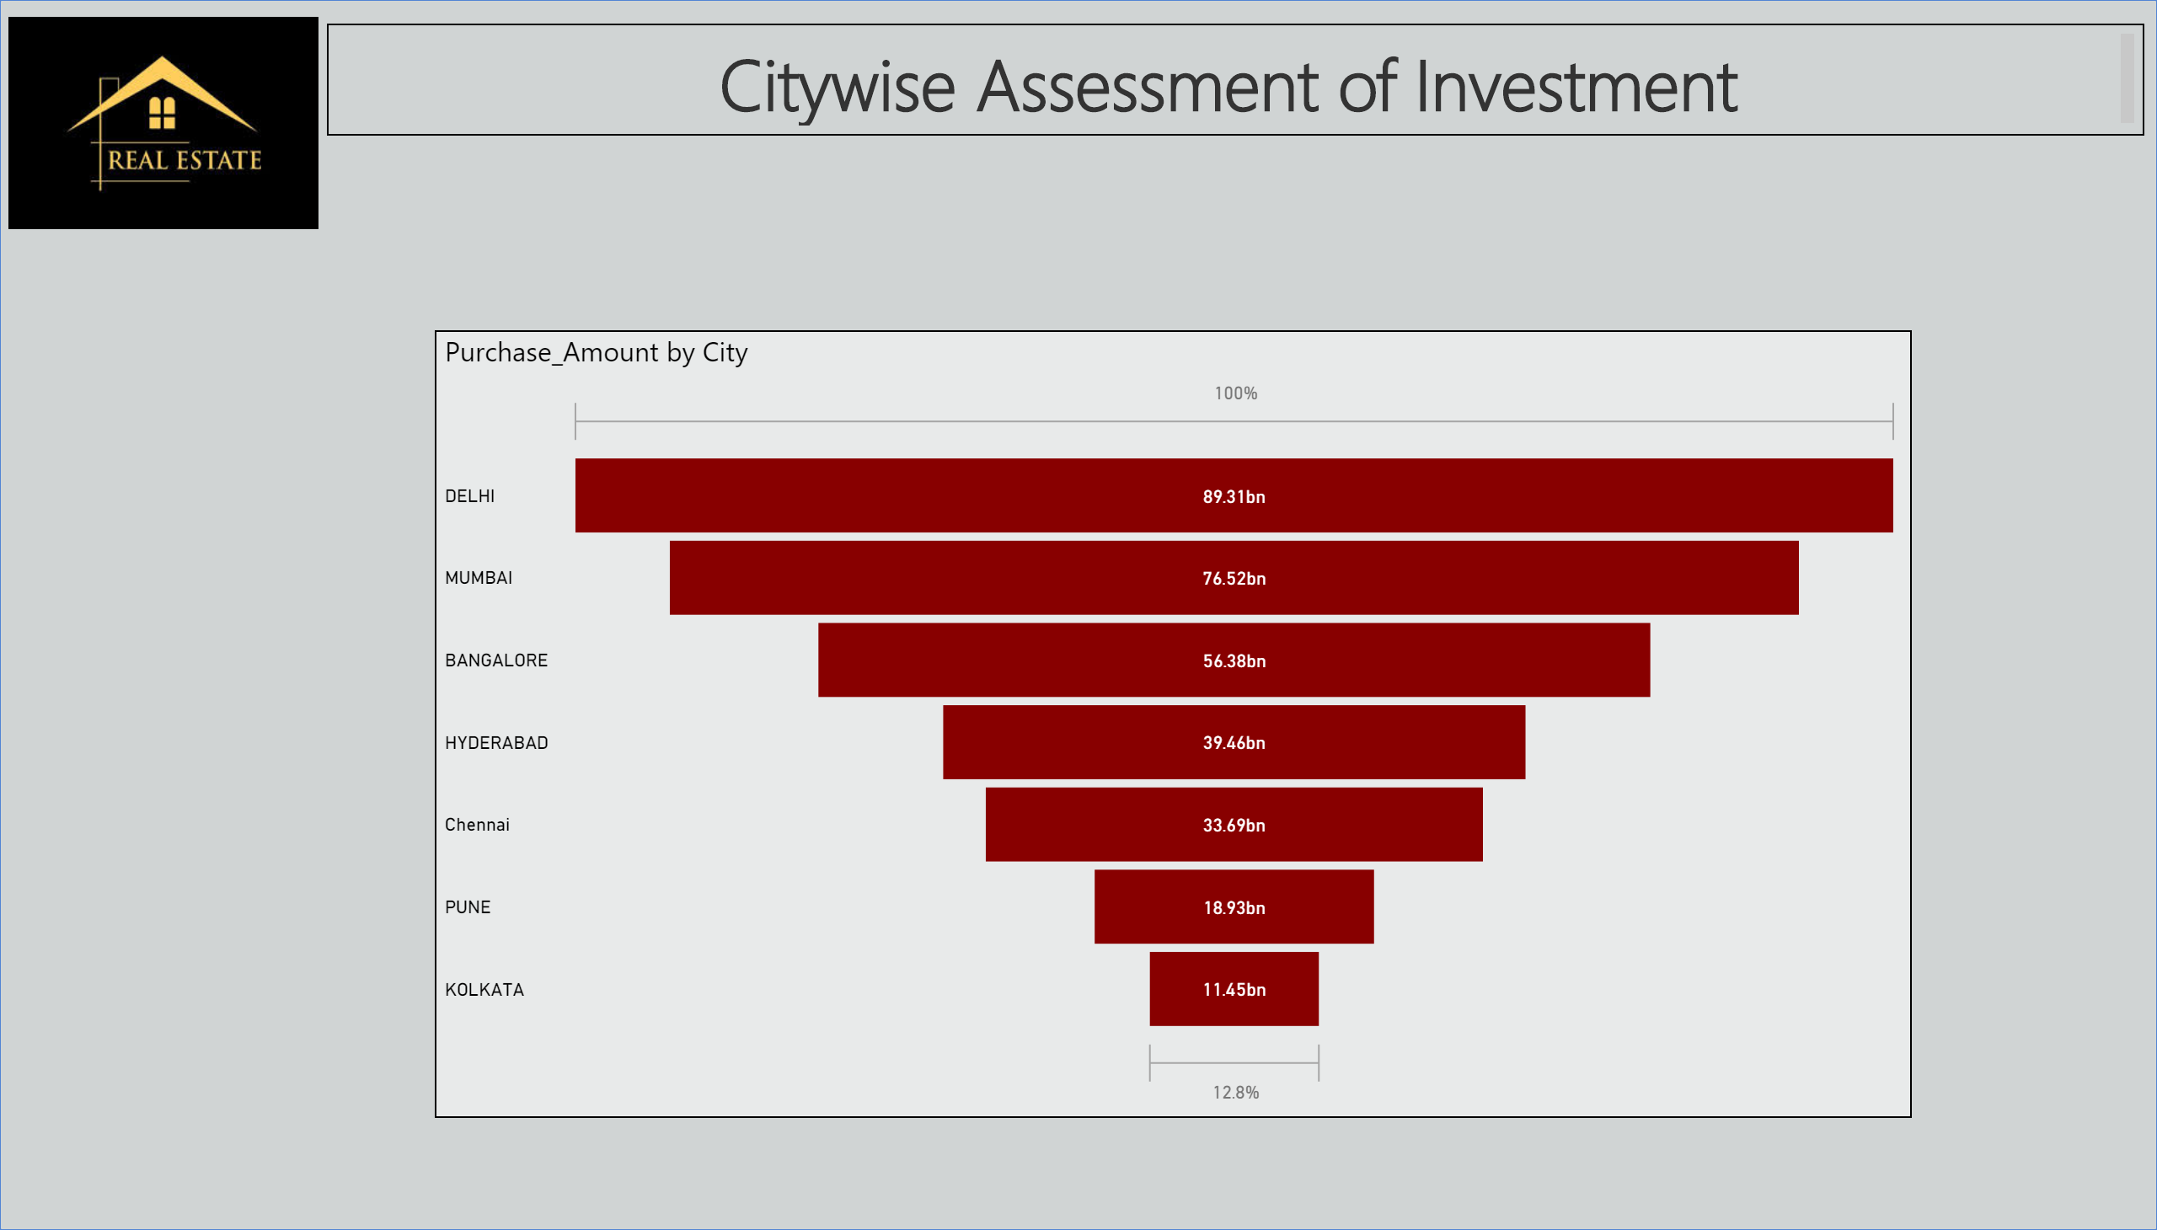

Slide 43
Any Queries ?

Slide 44
Thank You

